Slide 1

Fan Automation Using
PIR Sensor
TEITA_A3
St. Francis Institute of Technology
Department of Information Technology
Mini Project – Sensor Lab (ITL 603)
HIMANSHU CHAURASIYA 45
VIKAS CHAURASIYA 46
MUKESH GUPTA 47
ASHLY JOHN 48
`
Mentor:
Dr Minal Lopes
Assistant Professor

Slide 2
Overview
Introduction
Problem Statement
Objectives
Literature Survey
System Design
Circuit Diagram
Method/Approach
System Requirements
Implementation and Results
Conclusion
References

Slide 3
Introduction
The recent development in sensor network has lead to high uses of sensor for home automation purpose.
This project develops automatic fan switching system by sensing the presence of human being.
The project aim to save electricity and the manual need of fan switching ON and OFF.

Slide 4
Problem Statement
This project aims to develop a automated fan system using PIR sensor and HC-05 bluetooth module. It will work depending on the human presence in the room.

Slide 5
Objectives
To build a wireless fan system using HC-05 module and PIR sensor.
To switch the fan ON if a person is present in the room.

Slide 6
Literature Survey
Sr no | Title | Methodology | Future scope/ gap
1 | Development of Automatic Mini Fan with Human Detector by Using PIR Sensor. | The automatic mini fan with human detection system developed in the research paper consists of a combination of sensors such as PIR and LM35, a controller, a motor, and two types of power supplies, AC and DC, all of which are controlled by Arduino UNO as the main controller. | The system developed here has the potential to be commercialised in the future.
2 | Home Automation using Arduino and Bluetooth | At the receiver end, a Bluetooth module is linked to the Arduino board, while at the transmitter end, a GUI application on the mobile phone transmits ON/OFF commands to the receiver where loads are connected. When a key on the smartphone is touched, the Bluetooth module receives the corresponding data and instantly communicates it to Arduino. The Arduino then checks the received data to the data written in the code and turns on the load accordingly. | There must always be a connection between the mobile app and the HC-05 module for the system to function.

Slide 7
Literature Survey
Sr no | Paper | Methodology | Future scope/ gap
3 | Communication Concept Between Bluetooth As a Master and Slave To Exchange Digital Information | Using two hc-05 modules to connect master and slave with the help of an arduino. | Wireless automated systems can be created using this technology.
4 | Automatic Room Light Controller using Arduino and PIR Sensor | The suggested system is an automatic room light controller that makes use of an Arduino, a PIR sensor, and a relay module. | It can be used in college labs, schools , bathroom ,staircases in the house etc.

Slide 8
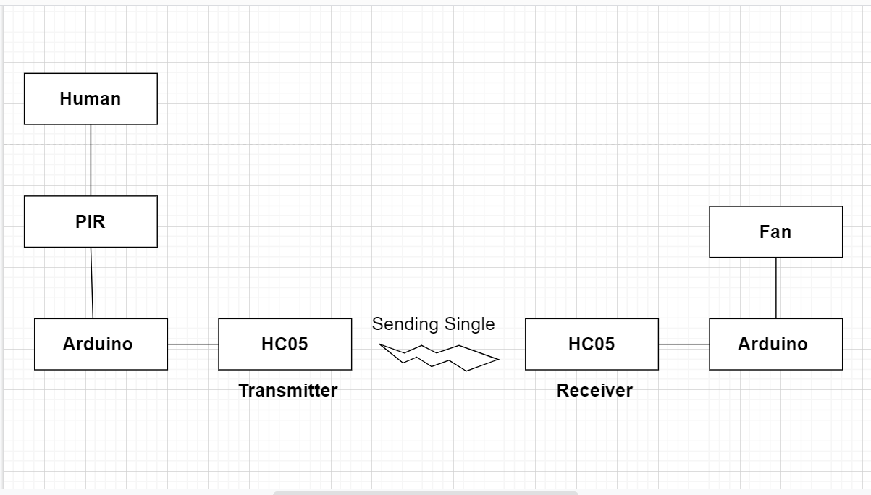
System Design

Slide 9
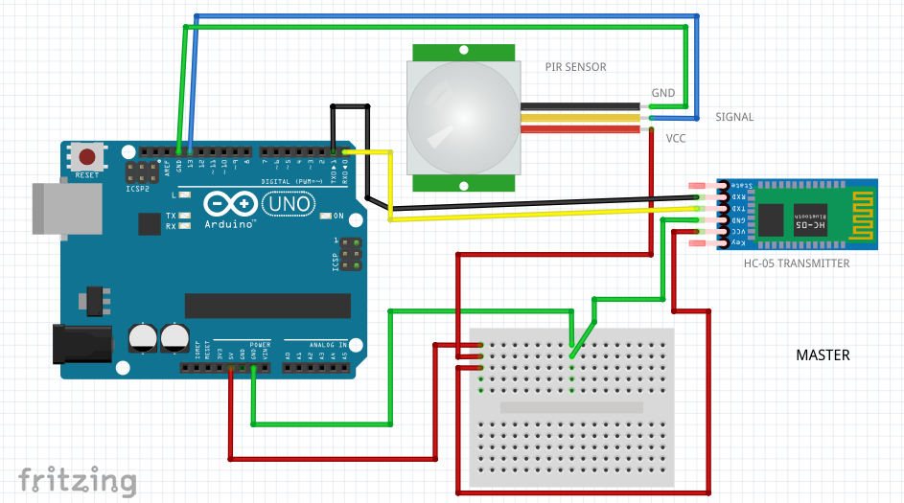
Circuit Diagram

Slide 10
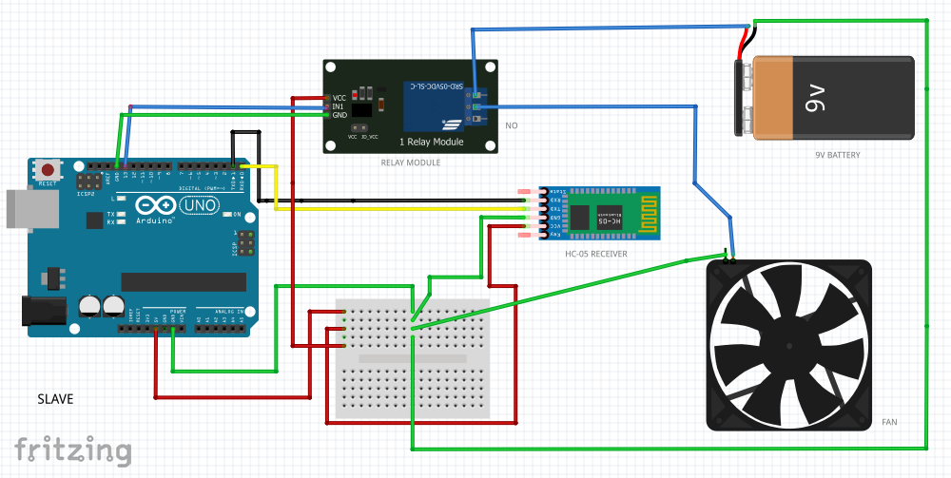
Circuit Diagram

Slide 11
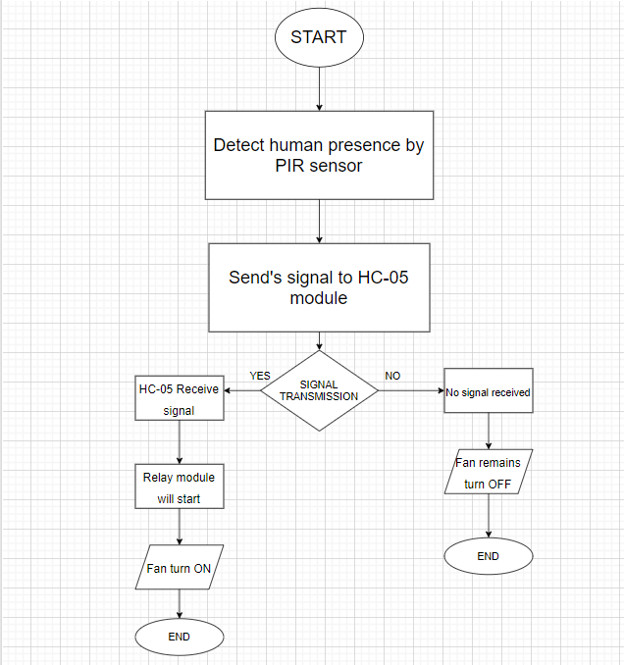
Methodology

Slide 12
System Requirements
Hardware, software requirements with cost
Sr.No. | Components | Cost
1 | Arduino Uno R3 sensor (X2) | 1100/-
2 | PIR Sensor | 65/-
3 | HC-05 module | 560/-
4 | DC Fan 12V | 95/-
5 | 12V Battery | 80/-
6 | Relay Module | 50/-
7 | Bradboard (X2) | 200/-
 | Total Cost | 2150/-

Slide 13
Software Requirements
Arduino.cc
Window 7 or above

Slide 14
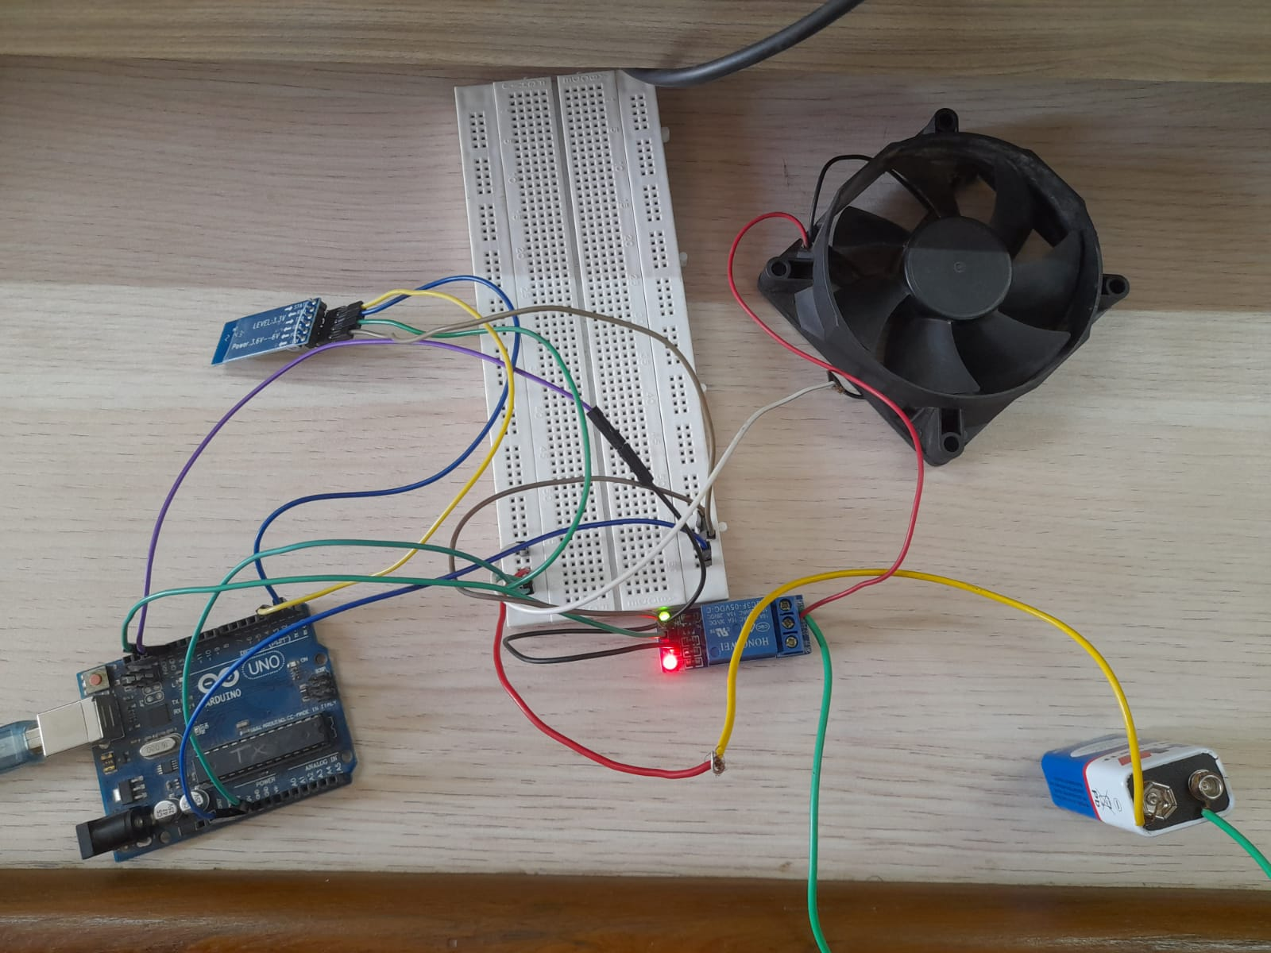
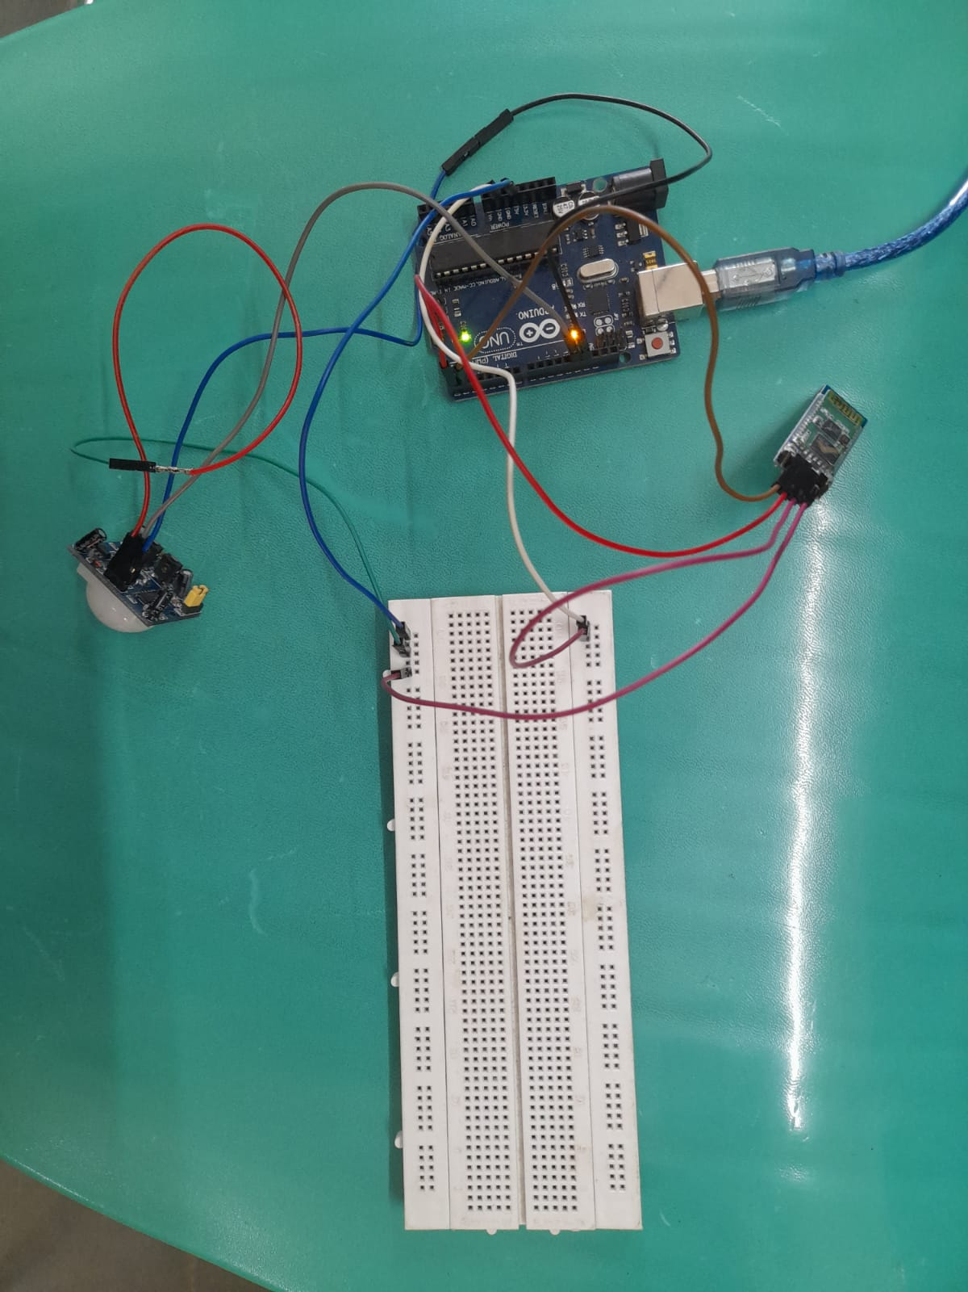
Implementation

Slide 15
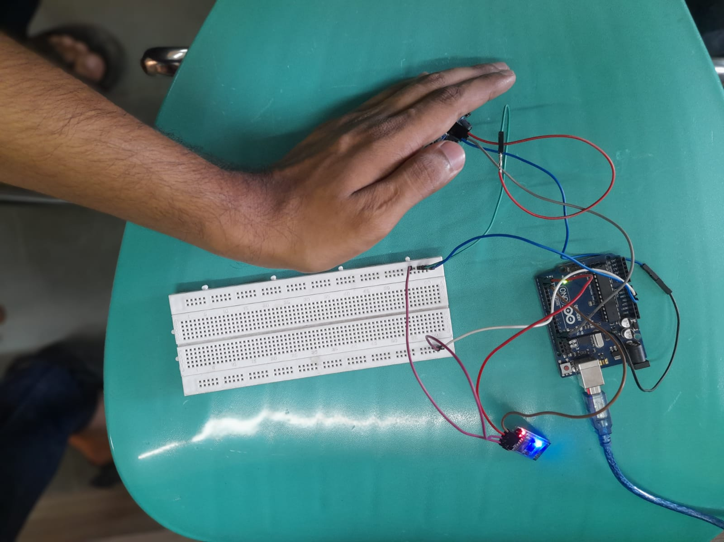
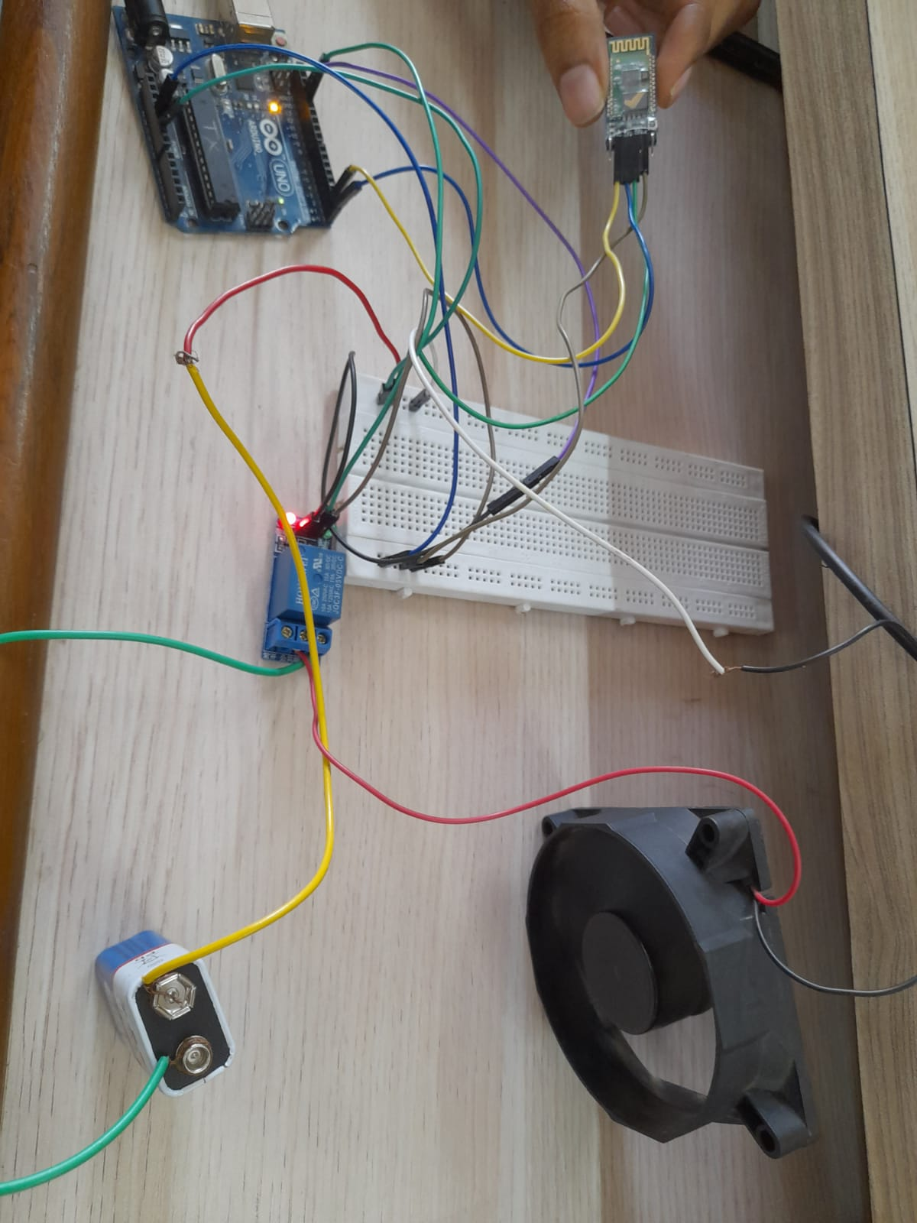
Results

Slide 16
Conclusion
We have developed an automated fan system.The purpose of this project was to build a automated fan with human detector capabilities by using the PIR sensor. This system can also be used to work with heavy home devices like AC’s.

Slide 17
References
Talib, N.A.A. & Kamarudin, Farhah & Shema, S.S. & Aziz, Azri. (2020). Development of Automatic Mini Fan with Human Detector by Using PIR Sensor. IOP Conference Series: Materials Science and Engineering. 932. 012081. 10.1088/1757-899X/932/1/012081.
Pravalika Bethi,Kukkala Ramya,Gande Preethi,Kokkonda Navya, "HOME AUTOMATION USING ARDUINO AND BLUETOOTH", International Journal of Creative Research Thoughts (IJCRT), ISSN:2320-2882, Volume.9, Issue 1, pp.1682-1688, January 2021, Available at :http://www.ijcrt.org/papers/IJCRT2101203.pdf
Agus Wibowo,"Communication Concept Between Bluetooth As a Master and Slave To Exchange Digital Information",International Journal of Engineering and Advanced Technology (IJEAT),ISSN: 2249-8958 (Online), Volume-9 Issue-2, December, 2019, Available at :https://www.ijeat.org/wp-content/uploads/papers/v9i2/B3222129219.pdf
Raju, Srujan & Sinha, Professor G. (2020). Automatic Temperature Control System Using Arduino. Advances in Intelligent Systems and Computing. 1090. 219-226. 10.1007/978-981-15-1480-7_18

